Slide 1
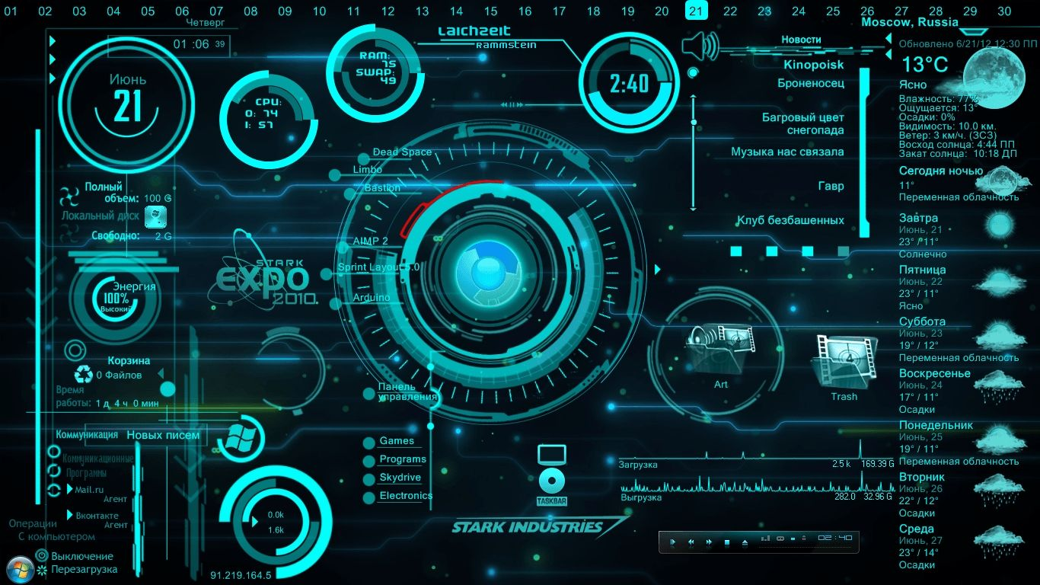

JARVIS – Desktop Assistant
Jarvis is a smart personal assistant
which does your work on your behalf
just with your voice command
Guided by :-
Prof. Manan Thakkar
Prepared by :-
Patel Het
Patel Karna
Pandya Kandarp

Slide 2

Jarvis
Desktop Assistant

Slide 3
Vision and Mission of Ganpat University
Vision | It shall be the constant endeavor of Ganpat University to meet the educational needs of the youth in the areas of professional studies and provide state-of the art learning opportunities along with inculcation of values of commitment and uprightness.
Mission | Seek, search and offer programs that lead to symbiotic emergence of 'academic excellence' and 'industrial relevance' in education and research.

Slide 4
Vision and Mission of Computer Engineering Department
Vision | Department aims to achieve its recognition as a leading contributor in the area of technical education of computer engineering by practicing latest principles, tools and technologies to cope with current and future challenges and hence contributing to global welfare.
Mission | To educate and inculcate strong fundamentals of science and computer engineering through best teaching learning practices. To impart high quality education to acquire skills to conduct research and solve complex problems through modern tools, technologies and innovative practices. Enabling youth for employability, social upliftment, following good moral practices and professional ethics. Preparing youth for contributing in advancements of technology and society. Encouraging students to be adaptive, courageous and life-long learners.

Slide 5
Capstone Project - III Course Outcomes
After successful completion of this course, student will be able to
Select, collect and use the required information/knowledge to solve the problem.
Logically choose relevant possible solution.
Assess the impact of project on society.
Communicate effectively and confidently as a member and leader of team.
Prepare the project report.

Slide 6

Outline
Introduction
Goal
Key Features
Literature Review
Technology Stack
How JARVIS Work
Future Enhancement
Benefits
Case studies
ER diagram
Future Vision
Prototype

Slide 7
Introduction
Imagine a digital assistant that understands your voice, anticipates your needs, and helps you get things done more efficiently. Jarvis is designed to be your personal productivity companion, streamlining tasks and making your daily routine smoother.
Inspired by the iconic AI from Marvel Comics, our Jarvis aims to bring a touch of futuristic convenience to your desktop. With its intuitive interface and advanced natural language processing capabilities, Jarvis is more than just a tool; it's a personalized assistant that learns and adapts to your unique preferences.

Slide 8
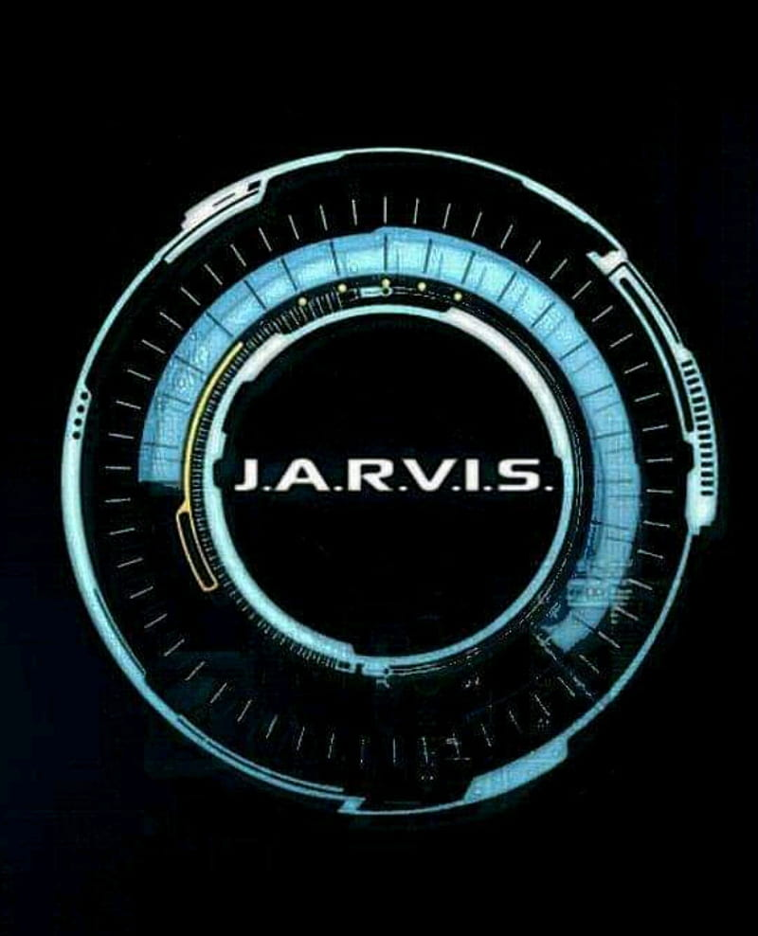
Goal
Make Life Easier:
Jarvis helps you with everyday tasks like setting reminders, organizing your schedule, and managing your to-do list.
Find Things Quickly:
It helps you find files, emails, and information online without you having to search manually.
3. Automate Repetitive Tasks:
Jarvis can handle repetitive tasks automatically, like opening apps, sending emails, or creating reports, saving you time.

Slide 9
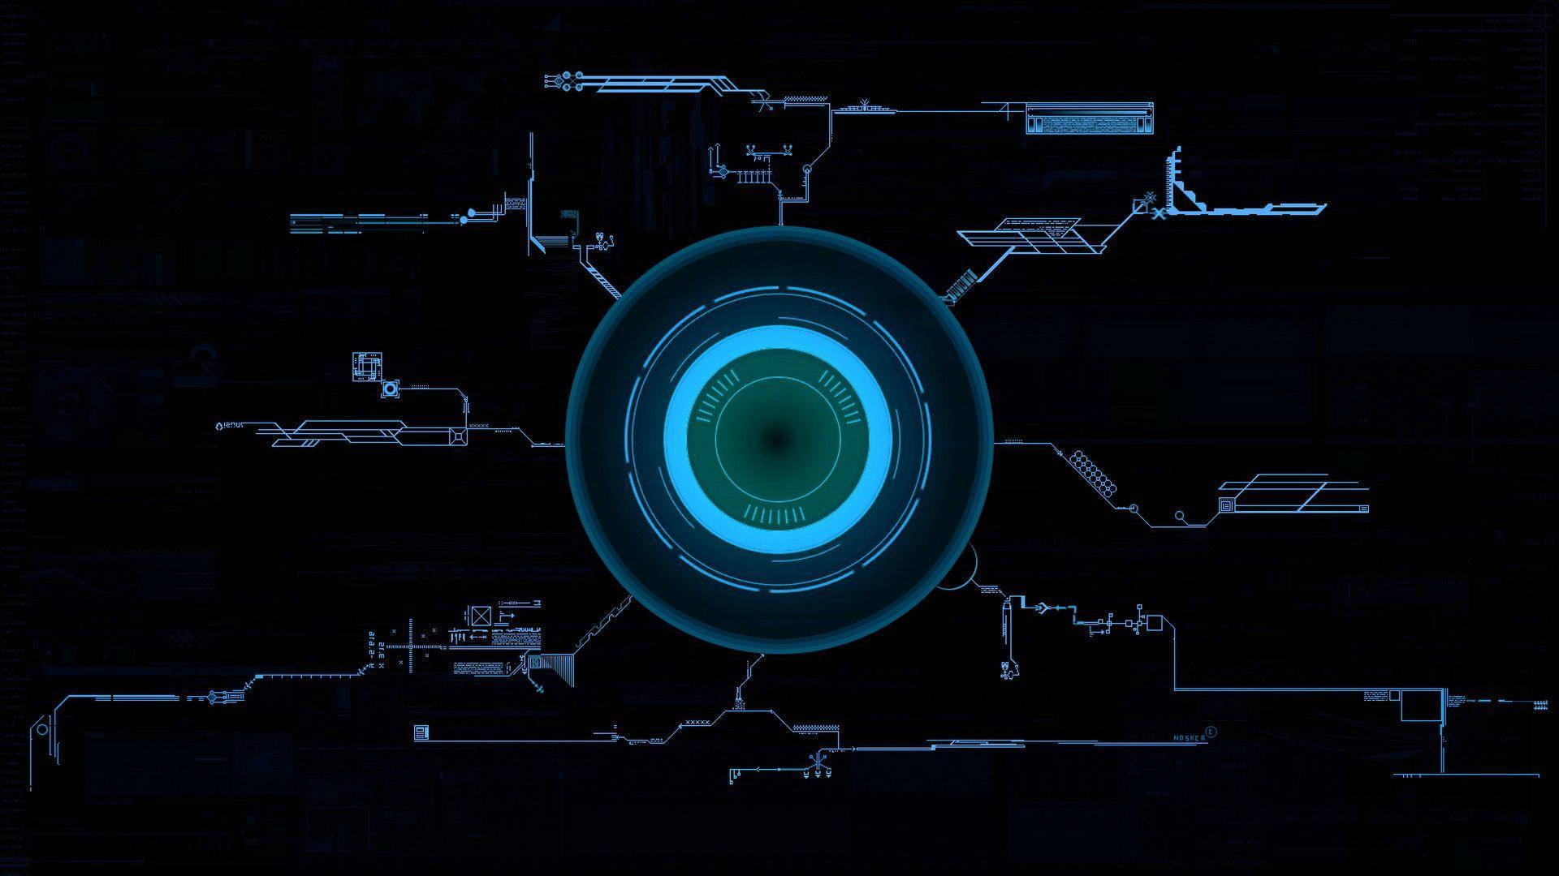
Key Features
Task Management
Smart Search
Automation
Voice and Text Commands
Calendar Integration
Personalized Help
Information and Answers

Slide 10
Literature Review
 | Features | Functionalities | Modules
OpenAI's GPT-3 | Natural Language Understanding and Generation. Task Adaptability. Scalability. | Writing Translating Answering Questions Summarizing Learning New Things | Transformer Architecture Self-Attention Positional Encoding
Google Assistant | Information and Search. Communication. Entertainment. Home Automation. | Information and Search Communication. Entertainment. Home Automation. | Input Processor Understanding Machine Task Execution Response Generator
Amazon Alexa | Information and Search. Communication. Entertainment. Home Automation. | Information and Search. Communication. Entertainment. Home Automation. | Input Processor Understanding Machine Task Execution Response Generator

Slide 11
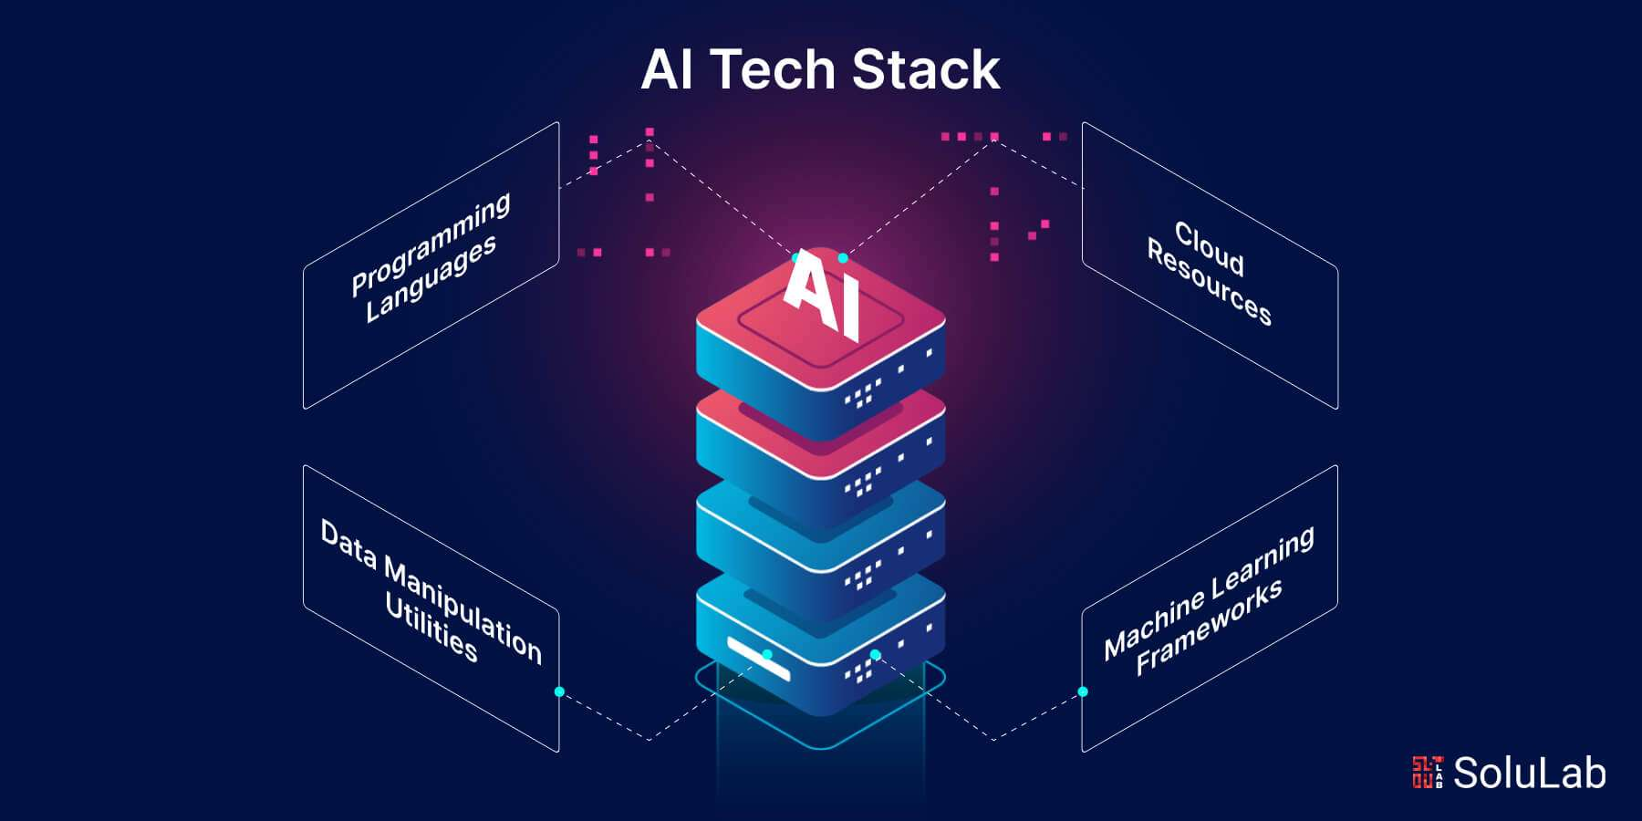
Technology Stack
Programming Language: Python
Libraries:
Speech Recognition
PyAudio
Pyttsx3
Beautiful Soup
Requests

Slide 12
How JARVIS Works
Listen: JARVIS listens to your voice.
Understand: JARVIS tries to figure out what you want.
Do: JARVIS does what you asked.
Tell: JARVIS tells you the answer or does the task.
Learn: JARVIS gets better at understanding you over time.

Slide 13
Future Enhancements
JARVIS could become even better in the future. It could learn to understand more complicated things you say and talk to you in a more natural way.
It could also use pictures and videos to help you. JARVIS might be able to guess what you need before you even ask. It could work with more devices and services, like your phone or other smart things in your home.
JARVIS could also learn about your likes and dislikes so it can suggest things you might like. It could even try to understand how you're feeling.
All of these things would make JARVIS more helpful and fun to use.

Slide 14
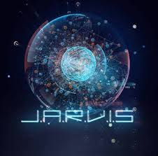
Benefits
Increased Efficiency:
Streamline tasks and save time.
Hands-Free Control:
Interact with your computer without typing.
Personalized Experience:
Adapt to your preferences and habits.

Slide 15
Case Studies
The Busy Student: A college student used JARVIS to manage their schedule, set reminders, and study more efficiently.
The Working Professional: A busy professional used JARVIS to automate tasks, schedule meetings, and control smart home devices.
The Senior Citizen: A senior citizen used JARVIS to stay connected with family, manage their medication, and receive reminders for appointments.

Slide 16
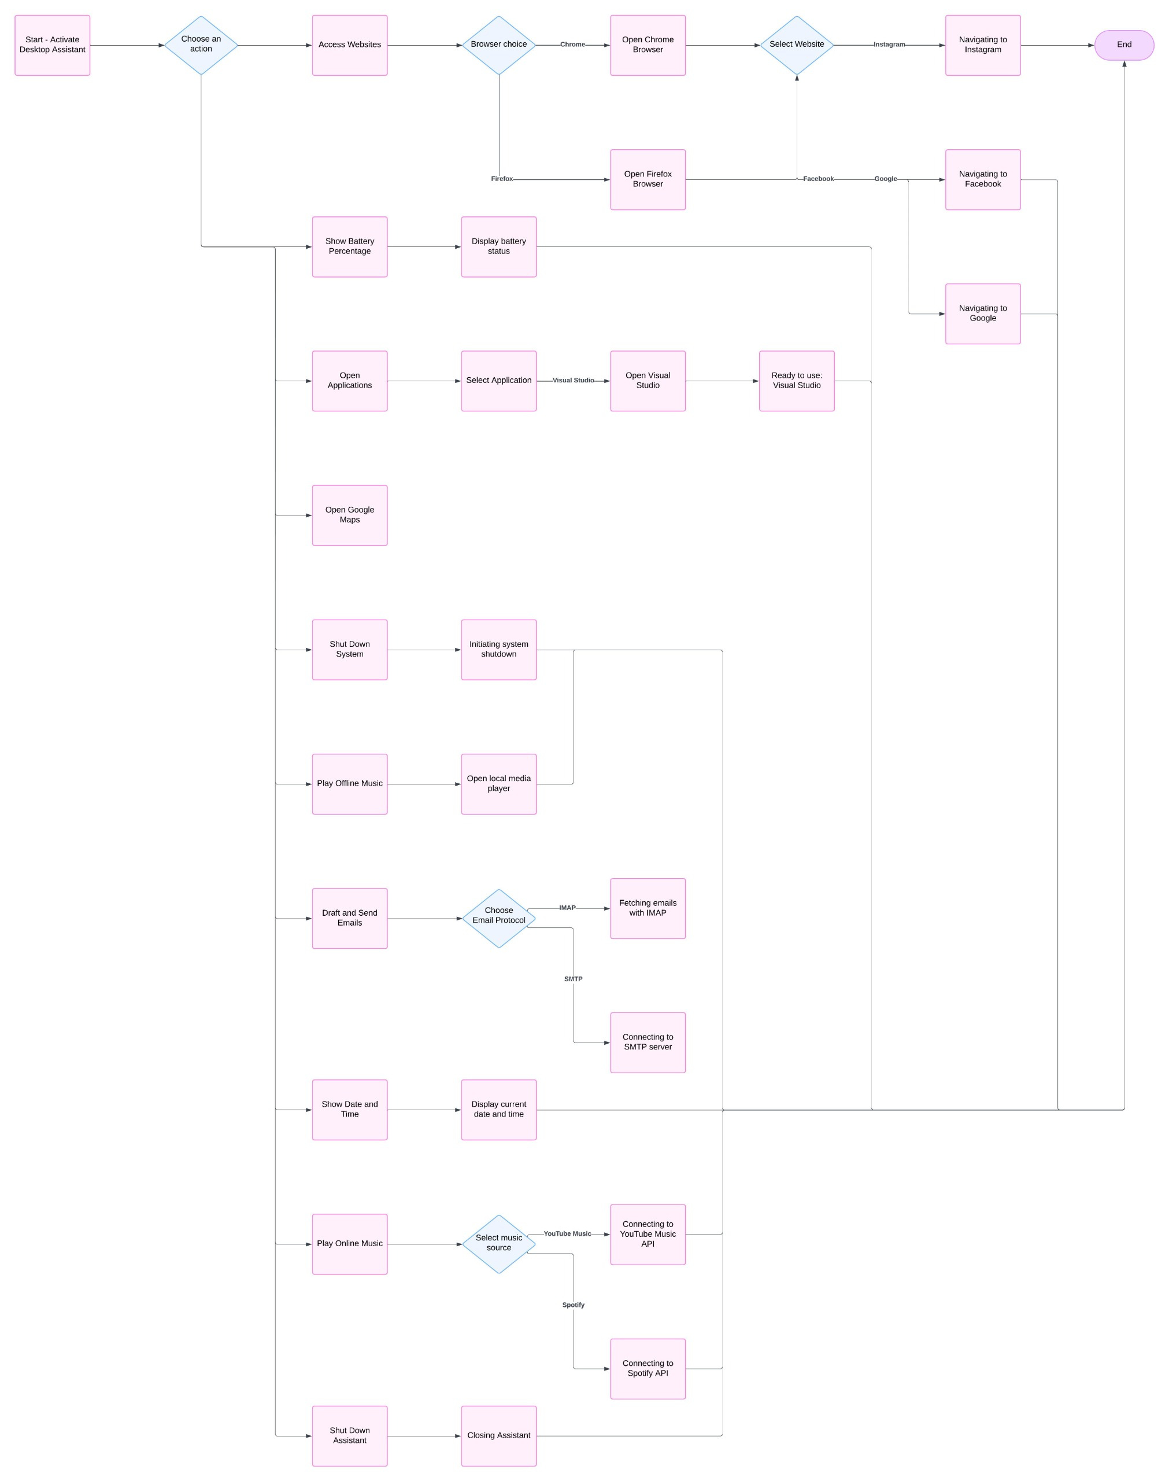
ER Diagram
Flow chart

Slide 17
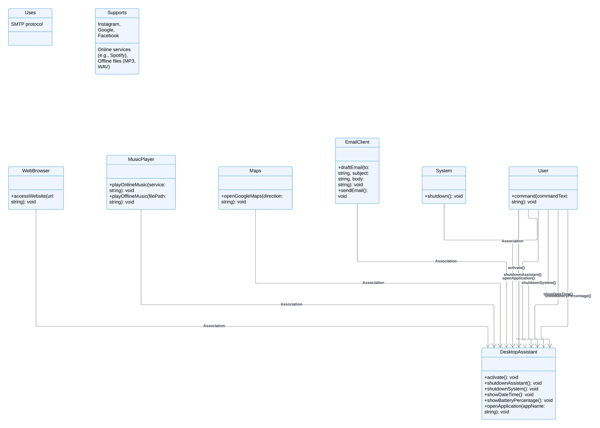
ER Diagram
2. Class diagram

Slide 18
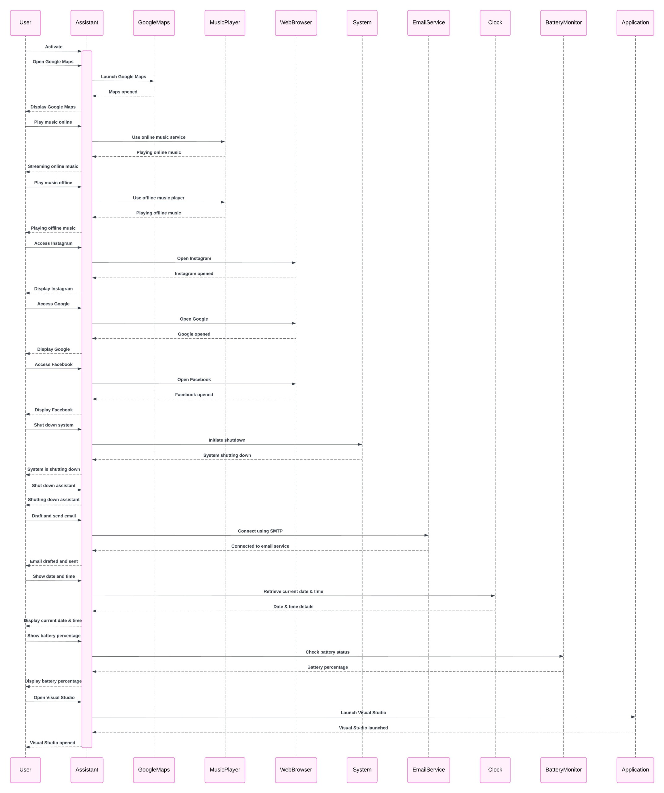
ER Diagram
3. Sequence Diagram

Slide 19
Future Vision
Understand you even better: JARVIS might be able to understand your thoughts and feelings more accurately.
Learn from your habits: It could suggest things you might like based on what you usually do.
Help you with more things: JARVIS could do more tasks, like booking appointments or ordering groceries.
Work with other devices: It could connect to even more devices and services, making your life easier.
Be more like a friend: JARVIS might become more like a friend, offering companionship and support.

Slide 20
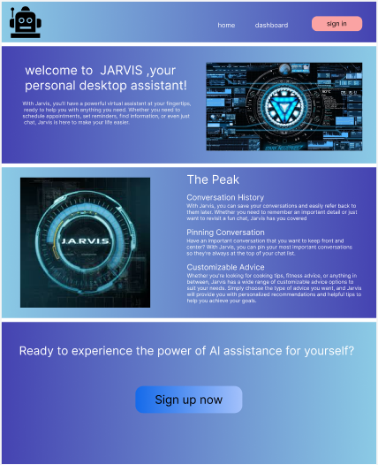
Prototype-1 (Home Page)

Slide 21
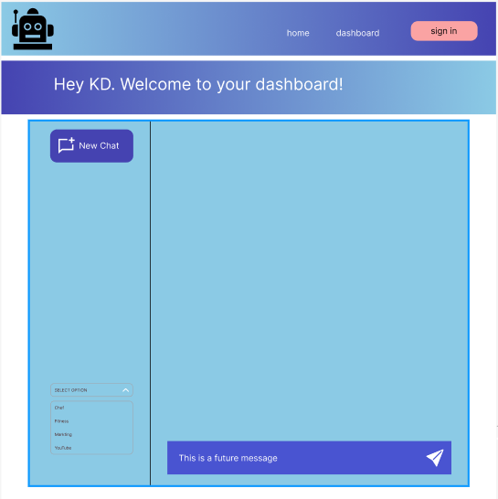
Prototype-2 (Sign In)

Slide 22
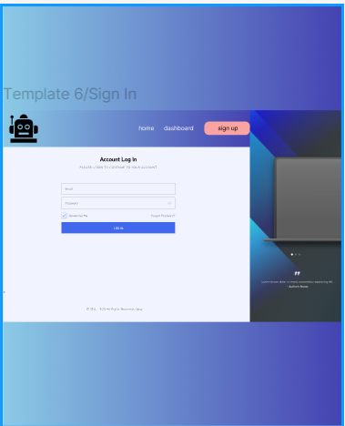
Prototype-3 (Login Page)

Slide 23
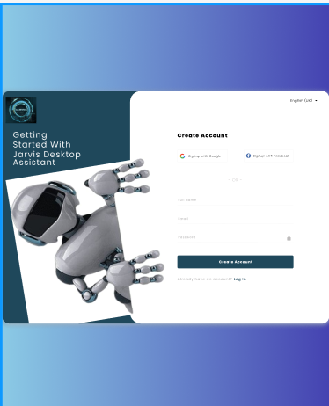
Prototype-4 (Sign Up)

Slide 24
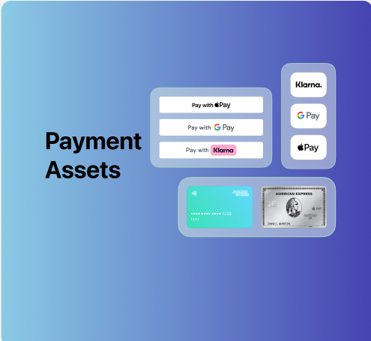
Prototype-5 (Payment Method)

Slide 25
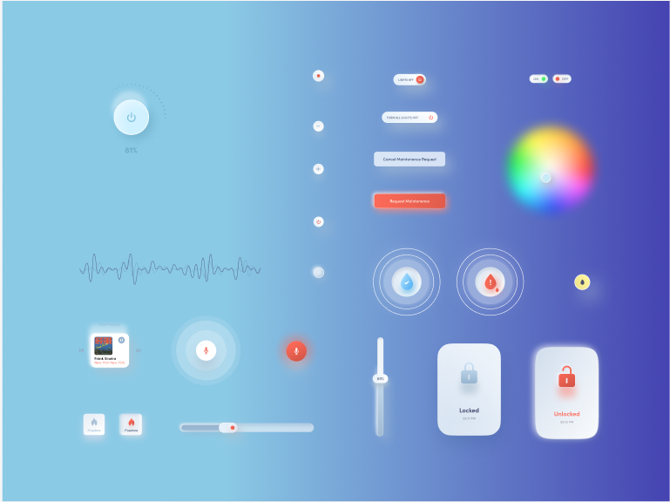
Prototype-6 (Smart Home 1)

Slide 26
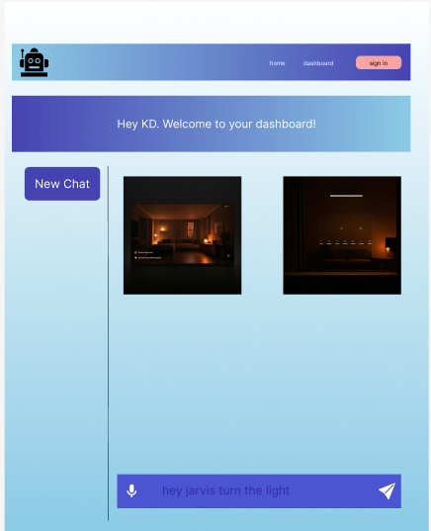
Prototype-7 (Smart Home 2)

Slide 27
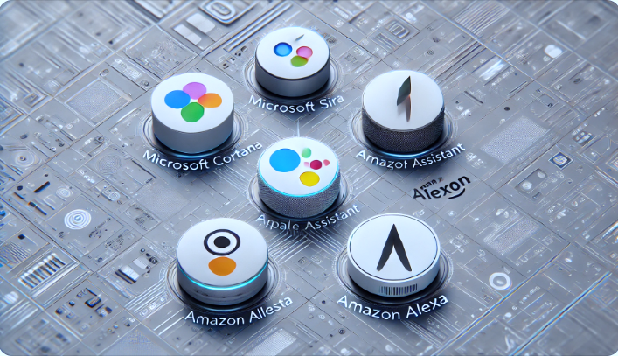
References
Microsoft Cortana: https://www.microsoft.com/en-us/cortana
Apple Siri: https://www.apple.com/siri/
Google Assistant: https://assistant.google.com/
Amazon Alexa: https://www.amazon.com/b?node=21576558011
Mycroft: https://community.openconversational.ai/

Slide 28


